Slide 1
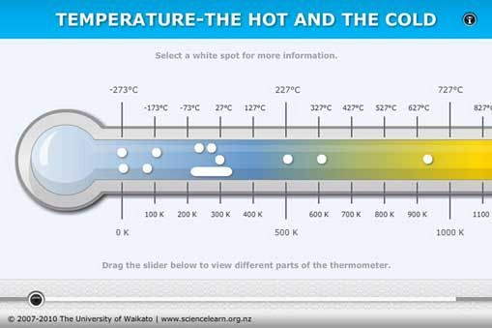
ZEROTH LAW OF THERMODYNAMICS AND PRESSURE
Dr.Joseph Daniel
SMBS

Slide 2
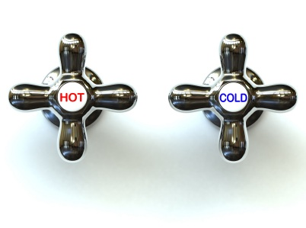
DEFINITION OF TEMPERATURE
Degree of hotness or coldness measured in a definite scale.
It is the driving force or potential causing flow of energy as heat.
Measure of the mean kinetic energy of the molecules of a system..
It determines whether or not a system is in thermal equilibrium with another system
It is an intensive property independent of the size or mass of the system.

Slide 3
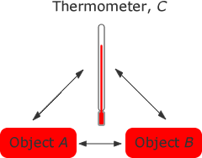
Zeroth Law of Thermodynamics states that “when two systems have equality of temperature (thermal equilibrium) to a third system, they in turn have equality of temperature with each other”

Slide 4
Thermometry
Defined as the act of measuring temperature with accuracy and precision.
Depends upon the establishment of thermodynamic equilibrium between the system and the device used to measure the temperature.
The sensing element of the device has certain physical characteristics which changes in value as a function of temperature.
A property or characteristic which changes in value as a function of temperature is called thermometric property and the corresponding substance is known as thermometric substance.

Slide 5
The physical characteristics….
Change in dimension (change in length by expansion or contraction)
Change in electrical resistance of metals and semiconductors.
Change in thermo electric emf of two alloys or metals joined together (thermocouples)
Change in intensity and color of emitted radiations
Fusion of materials when exposed to temperature (Pyrometric cone)

Slide 6
Mathematical relationship
T= Ax (Direct proportionality)
T = Ax+B (Linear)
T = Ax²+Bx+C (Quadratic)
T = A+Bx+Cx²+Dx³ (Polynomial)

Slide 7
Temperature Scale
Centigrade and Farenheit scale
Kelvin and Rankine cycle
t_{c} = 5/9(t_{f} -32).
Kelvin and Rankine scales of no molecular activity and no heat content is referred as absolute zero.
-273.16ºC and -459.67ºF.
T(K) = T(ºC ) + 273.16 and T(R ) = T (ºF) + 459.67

Slide 8
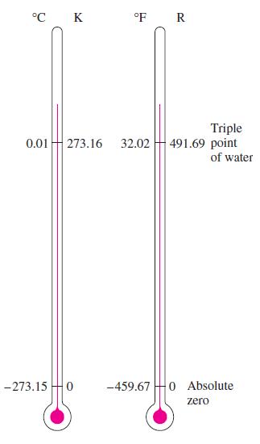
l
Thermodynamic scale by Lord Kelvin.
“the ratio of any two temperatures in the kelvin or thermodynamic scale is equal to the ratio of heat rejected by a carnot engine operating between those temperatures”
In 1954, at the 10th conference of weights and measures the fixed point was chosen as the triple point of water.
Triple point : all states co exist.

Slide 9
Problem 1
Two thermometers, one having the centigrade scale and other in farenheit scale are immersed in a liquid, after equilibrium is reached it was found out that they indicate the same numerical value, identify this numerical value?

Slide 10
Problem 2
The readings t_{A} and t_{B} of two thermometers A and B on celsius scale agree at the ice point and steam point and is related by the expression t_{A}= l+mt_{B}+nt_{B}² where l,m,n are constants.
When both of them are immersed in a well stirred oil bath A will read 51ºC and B reads 50 ºC. Determine the reading on the thermometer A when B reads 25ºC.

Slide 11
Precision and accuracy
precision of a measurement system, also called reproducibility or repeatability, is the degree to which repeated measurements under unchanged conditions show the same results
the accuracy of a measurement system is the degree of closeness of measurements of a quantity to that quantity's actual (true) value.

Slide 12
RESISTANCE THERMOMETER
Electrical resistance of most metals increases with temperature.
An adequate relationship may be expressed as
R_{t}= R_{o}(1+at+bt²)
Where R_{t} is the resistance at any temperature tºC, R_{o} is the resistance at 0ºC and a and b are constants.
R= R_{o}(1+at) is also valid for limited temperature ranges.

Slide 13
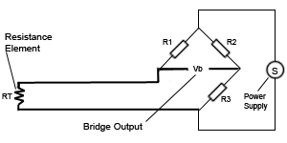
The circuit…
The thermometer consists of a resistance element, electrical leads and a resistance measuring device.
The resistance element is in the form of very fine platinum, nickel or copper wound on a non conductive medium like ceramic and enclosed in a pyrex glass tube.
Resistance is measured by a Wheatstone bridge.

Slide 14
Types
Carbon resistor elements are widely available and are very inexpensive. They have very reproducible results at low temperatures. They are the most reliable form at extremely low temperatures. They generally do not suffer from significant hysterisis or strain gauge effects.
Strain free elements use a wire coil minimally supported within a sealed housing filled with an inert gas. These sensors are used up to 961.78 °C. It consists of a platinum wire loosely coiled over a support structure so the element is free to expand and contract with temperature, but it is very susceptible to shock and vibration as the loops of platinum can sway back and forth causing deformation.
Thin film elements have a sensing element that is formed by depositing a very thin layer of resistive material, normal platinum, on a ceramic substrate. This layer is usually just 10 to 100 angstroms (1 to 10 nanometers) thick. This film is then coated with an epoxy or glass that helps protect the deposited film and also acts as a strain relief for the external lead-wires. They also can only be used over a limited temperature range due to the different expansion rates of the substrate and resistive deposited giving a "strain gauge" effect that can be seen in the resistive temperature coefficient. These elements work with temperatures to 300 °C.

Slide 15
Wire wound
Wire-wound elements can have greater accuracy, especially for wide temperature ranges.
The sensing wire is wrapped around an insulating mandrel or core. The winding core can be round or flat electrical insulator.
The coefficient of thermal expansion of the winding core material is matched to the sensing wire to minimize any mechanical strain. This strain on the element wire will result in a thermal measurement error.
The sensing wire is connected to a larger wire, usually referred to as the element lead or wire. This wire is selected to be compatible with the sensing wire so that the combination does not generate an emf that would distort the thermal measurement.
These elements work with temperatures to 660 °C.

Slide 16
Coiled elements
Coiled elements have largely replaced wire-wound elements in industry. This design has a wire coil which can expand freely over temperature, held in place by some mechanical support which lets the coil keep its shape. This “strain free” design allows the sensing wire to expand and contract free of influence from other materials.
The basis of the sensing element is a small coil of platinum sensing wire. This coil resembles a filament in an incandescent light bulb. The housing or mandrel is a hard fired ceramic oxide tube with equally spaced bores that run transverse to the axes. The coil is inserted in the bores of the mandrel and then packed with a very finely ground ceramic powder. This permits the sensing wire to move while still remaining in good thermal contact with the process. These Elements works with temperatures to 850 °C.

Slide 17
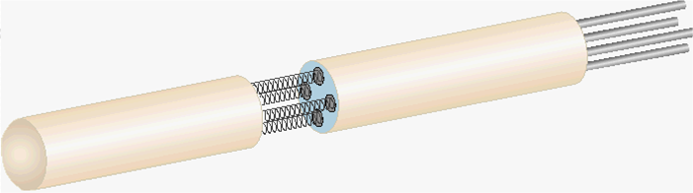
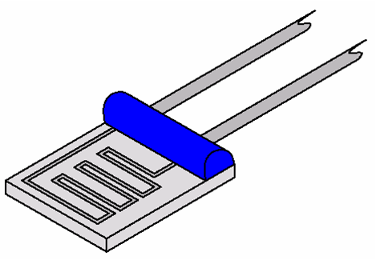
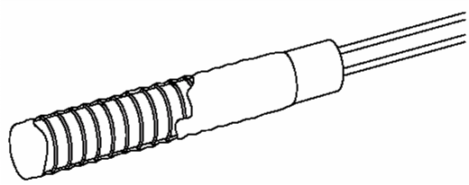
Coiled type
Wire wound
Thin films

Slide 18
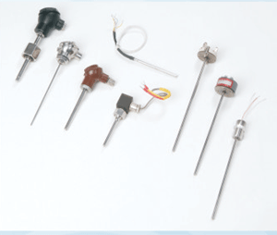
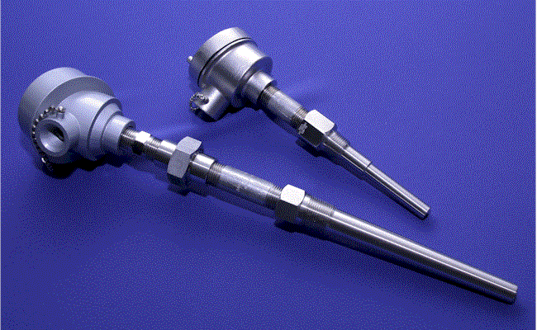
Some RTD’s

Slide 19
Thermocouples
It consists of two dissimilar electrical conductors joined at 2 ends to form a closed loop.
When a temperature difference exists between the junctions, an emf is set up.
The emf depends upon temperature difference and materials involved.
One end may be maintained at the ice point as a standard.
The emf produced is taken as the index of the temperature of the other end.

Slide 20
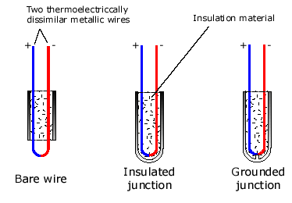
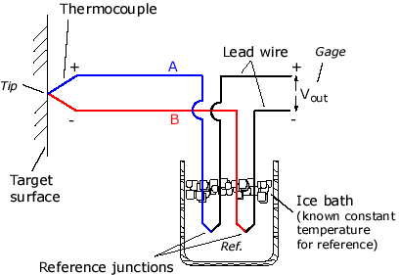

Slide 21
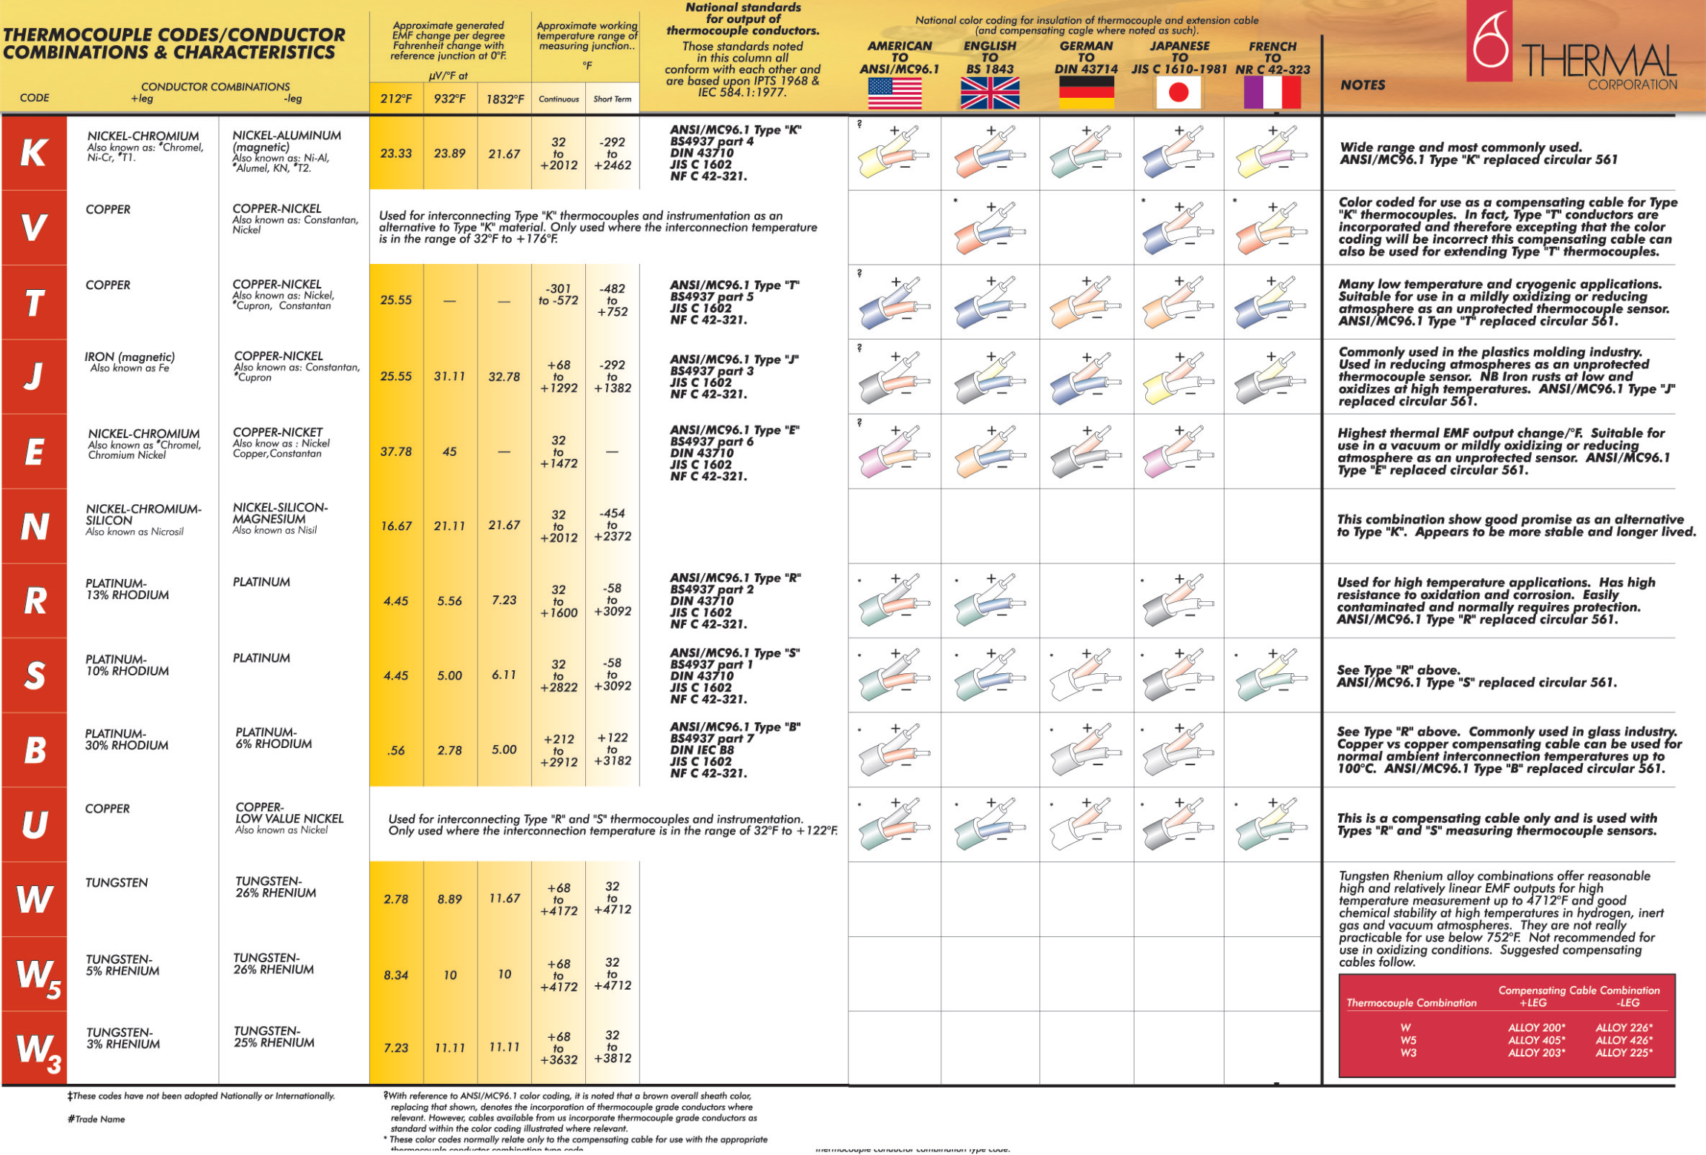

Slide 22
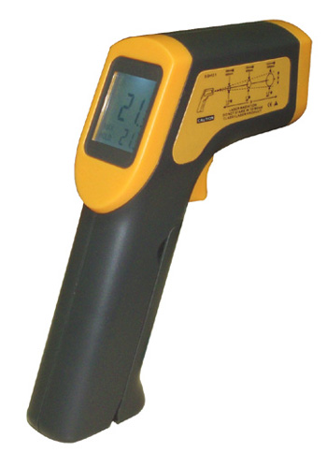
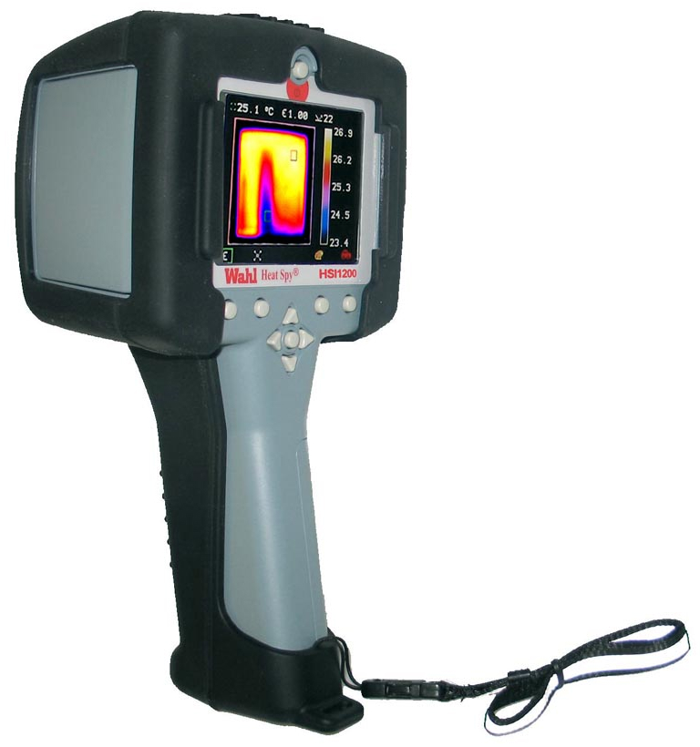
Non contact thermometry

Slide 23
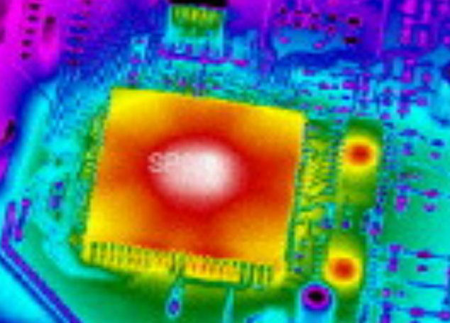

Slide 24
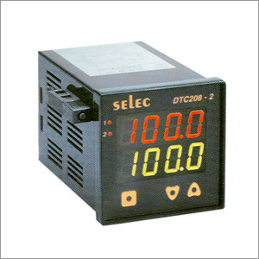
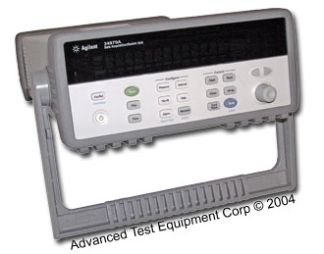
Temperature Indicator and Data Logger

Slide 25
PRESSURE
Pressure is the action of one force against another over, a surface. The pressure P of a force F distributed over an area A is defined as:
P = F/A

Slide 26
How is pressure generated?
Collision of molecule with wall
Momentum is mass x velocity
Change of momentum is double
Collision is isothermal = perfectly elastic
Sum collisions over area to get force

Slide 27
How Much is a kilo Pascal (kPa)?
1 atmosphere (14.7 psi, 750mmHg) is approximately 100 kPa = 1 bar
1 kPa is about 7 mmHg
1% of a gas at our altitude is about 7 mmHg

Slide 28
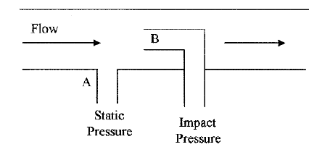
Static, dynamic, and impact pressures
Static pressure is the pressure of fluids or gases that are stationary or not in motion.
Dynamic pressure is the pressure exerted by a fluid or gas when it impacts on a surface or an object due to its motion or flow. In Fig., the dynamic pressure is (B − A).
Impact pressure (total pressure) is the sum of the static and dynamic pressures on a surface or object. Point B in Fig. depicts the impact pressure.
Notes:
Point A is considered as static pressure although the fluid above it is flowing.

Slide 29
Definition Of Pressure

Slide 30
Definition Of Pressure
Absolute pressure
The pressure is referenced to zero absolute pressure and has units of
psia. Absolute pressure can only have a positive value.
Gauge pressure
The pressure is referenced to atmospheric pressure and by convention
is measured in the positive direction, i.e. 7 psig.
Vacuum pressure
The pressure is referenced to atmospheric pressure and by convention
is measured in the negative direction, i.e. -50 mm Hg.

Slide 31
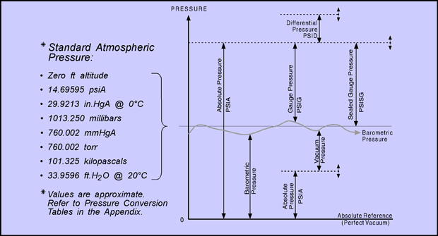
Standard Atmospheric Pressure

Slide 32
Pressure Measurement
A number of measurement units are used for pressure. They are as follows:
Pounds per square foot (psf) or pounds per square inch (psi)
Atmospheres (atm)
Pascals (N/m²) or kilopascal (1000Pa)*
Torr = 1 mm mercury
Bar (1.013 atm) = 100 kPa
14.696 lbf/in2 equals 33.9 feet of H2O
14.696 lbf/in2 equals 29.921 inches of of Hg

Slide 33
Pressure Units
The following conversion factors should help in dealing with the various units:
1 psi= 51.714 mmHg = 2.0359 in.Hg = 27.680 in.H₂O = 6.8946 kPa
1 bar= 14.504 psi 1 atm. = 14.696 psi

Slide 34
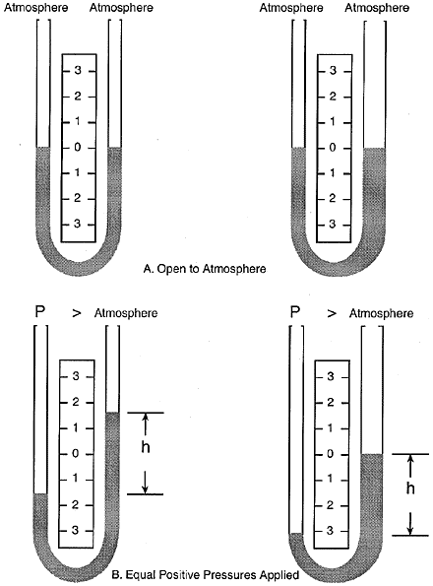
Variations on the U-Tube Manometer
The pressure reading is always the difference between fluid heights, regardless of the tube sizes.
With both manometer legs open to the atmosphere, the fluid levels are the same (A).
With an equal positive pressure applied to one leg of each manometer, the fluid levels differ, but the distance between the fluid heights is the same (B).
Notes:
The differential pressure is always the difference in column heights, regardless of the size or shape of the tubes.
As shown in next slide, the legs of both manometers are open to the atmosphere and the indicating fluids are at the same level.
Connecting the same pressure to the left leg of each manometer causes its level to lower.
Because of the variation in volume in the manometer legs, the fluid in each column moves a different distance. However, the difference between the fluid levels in both manometers is identical.

Slide 35
Sensing Elements
The main types of sensing elements are
Bourdon tubes,
diaphragms,
capsules, and
bellows .
All except diaphragms provide a fairly large displacement
that is useful in mechanical gauges and for electrical
sensors that require a significant movement.

Slide 36
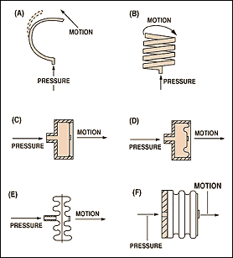
Sensing Elements
The basic pressure sensing element can be configured as a C-shaped Bourdon tube (A); a helical Bourdon tube (B); flat diaphragm (C); a convoluted diaphragm (D); a capsule (E); or a set of bellows (F).

Slide 38
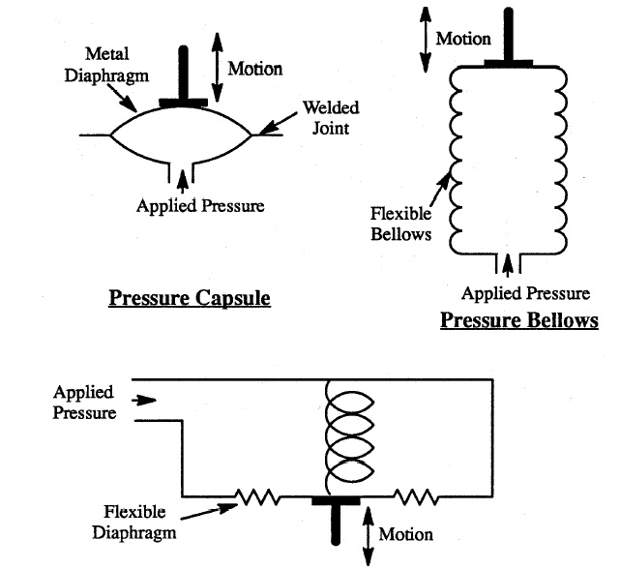
Primary Pressure Elements Capsule, Bellows & Spring Opposed Diaphragm

Slide 39
Bellows
Made of Bronze, S.S., BeCu, Monel etc..
The movement is proportional to number of convolutions
Sensitivity is proportional to size
In general a bellows can detect a slightly lower pressure than a diaphragm
The range is from 0-5 mmHg to 0-2000 psi
Accuracy in the range of 1% span

Slide 40
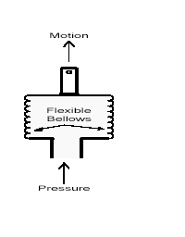
Bellows

Slide 41
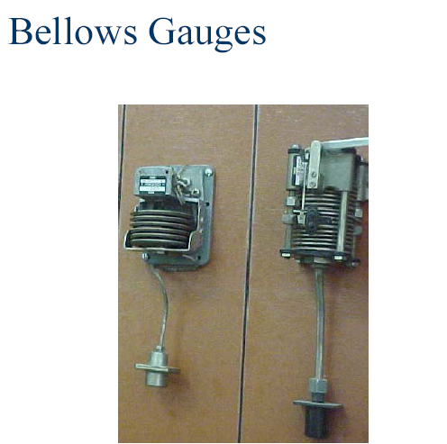

Slide 42
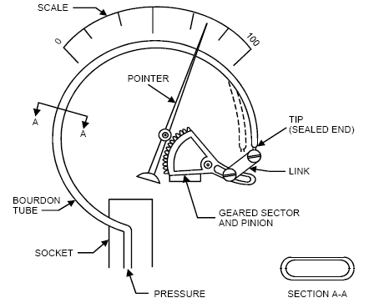
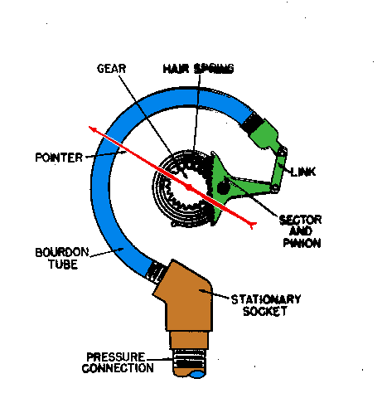
Bourdon Tube

Slide 43
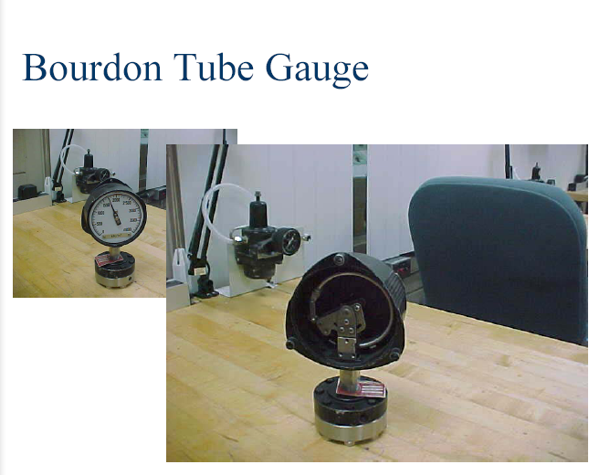

Slide 44
Bourdon Tubes
(a) C-type tube.
(b) Spiral tube.
(c) Helical tube

Slide 45
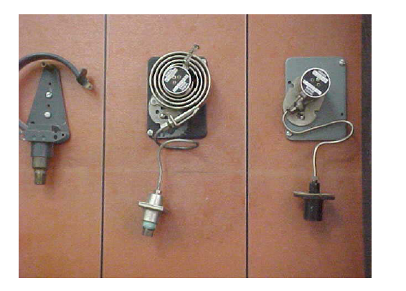
Bourdon Tubes

Slide 46
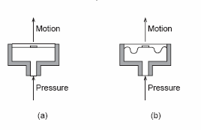
Diaphragm
(a) flat diaphragm; (b) corrugated diaphragm
A diaphragm usually is designed so that the deflection-versus-pressure characteristics are as linear as possible over a specified pressure range, and with a minimum of hysteresis and minimum shift in the zero point.

